Slide 1
Labour supply responses to the COVID supplement
Erin Clarke, Matt Nolan, Ali Vergili

Slide 2
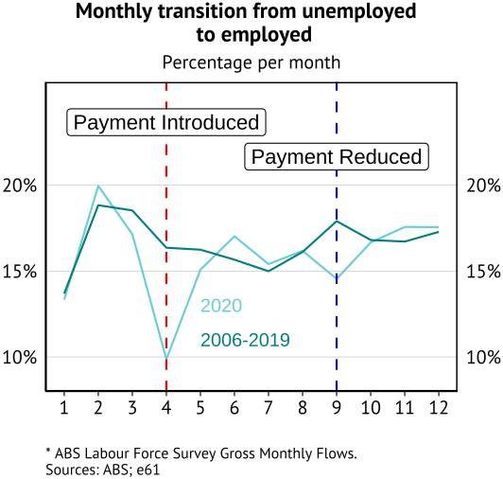
What are we asking?
Research question: how do people respond to changes in the benefit rate?
In order to answer this, we focus on the introduction of the COVID supplement in 2020.
By examining the effects of increased JobSeeker payments, we can assess whether people were encouraged to remain unemployed or if the support helped sustain engagement with the labour market during a period of limited job opportunities.
COVID-19 effects are complex, but using New Zealanders in Australia as a control helps isolate the effects of JobSeeker changes. New Zealanders share many similarities with Australians but couldn’t access JobSeeker and were unable to leave the country, providing a valuable comparison.

Slide 3
What do we find?
Large reduction in job-finding rate (19%) and increase in separation rate (doubling) following the announcement of COVID supplement.
More limited response to the announced extension of the COVID supplement.
First announcement (March) coincided with removal of mutual obligations, second announcement (July) with their reintroduction – suggestive evidence of large employment effects of such obligations (i.e. Herault and Wilkins 2020).

Slide 4
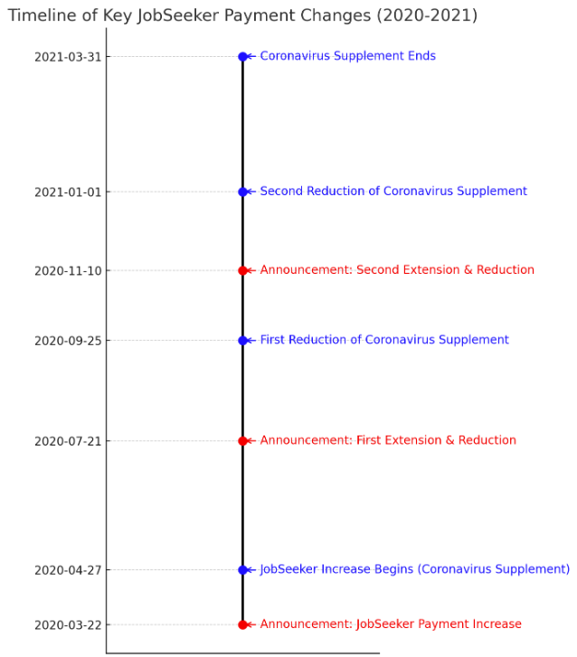
Second announcement
First announcement

Slide 5
Approach
There were three COVID supplement announcements in 2020. We use a Regression Discontinuity approach to evaluate if job-finding rates and separation rates changed following the first two of these announcements.
Both announcements increased the present value of being on the benefit. As a result, we would expect:
A reduction in job-finding rates as individuals reduce job search effort.
An increase in separation rates as individuals leave low value jobs.
However, these announcements were not exogenous – policies were announced due to economic shocks that will have also reduced job-finding rates and increased separation rates.
We construct a counterfactual group of New Zealanders who live in Australia – who were ineligible to receive the COVID supplement but experienced the same economic and health shocks – and estimate an RDD of the difference in job-finding and separation rates for Australians and New Zealanders.
The data used is transactional STP (tax return) and DOMINO (benefit) data, analysed on a weekly basis. Visa data is used to identify New Zealanders who are unable to access support, and the group of Australians and New Zealanders considered is found through matching.

Slide 6
New Zealanders as a control group
New Zealanders have similar educational and cultural backgrounds to Australia – New Zealand is included in the Australian constitution.
New Zealanders have unlimited work rights, access to health care, and for most policies are treated as Australians (i.e. Family Tax Benefit).
However, New Zealanders cannot receive the JSP or NDIS.
New Zealanders have free travel between New Zealand and Australia. However, during COVID the borders closed (from late March) and the cost of travelling increased substantially.
As a result, a historically small number of New Zealanders left in the June quarter of 2020 – and departure numbers only returned to historically “normal” levels afterwards.
We focus on New Zealanders and Australians who remained in the country during 2020.

Slide 7
Data construction
We use a dataset of matched Australians and New Zealanders.
The Australians and New Zealanders that are considered had to spend time out of work in 2020 – if we limit our sample to those who experience job loss in 2020 the estimated effects become larger.
Due to limitations in the STP, we only consider firms that exist in the STP data prior to July 2020. Furthermore, we drop individuals that are only observed to work in the “new” firms from the analysis. This has little effect on our results.
We append PAYG annual data for FY19 to FY22, along with Visa and benefit data, to form our dataset.
Our announcement dates are:
First announcement: 22 March 2020 – the day the COVID supplement was announced along with other economic measures due to earlier lockdowns and breakouts.
Second announcement: 23 June 2020 – when it was indicated that there would be further extensions in the JSP due to lockdowns, but no details were given. An alternative second is 21 July 2020, when it was announced that the extension would involve a lower payment and mutual obligations.

Slide 8
Matching
How do we find comparable groups of Australians and New Zealanders?
Solution: To address this, we use a matching approach to create a comparable group of Australians.
We calculate each individual's likelihood of being in the JobSeeker recipient group based on:
Age, Gender, Previous Income (individual and family), Marital Status, Region (State and SA4), Industry, Occupation (1 and 2-digit ABS code).
Using these factors, we generate propensity scores to estimate the probability of receiving JobSeeker benefits.
Matching Step: Each unemployed New Zealander is matched to an Australian JobSeeker recipient with the closest propensity score, creating a balanced comparison group.
We perform this matching 1-1 on all Australians and New Zealanders in our dataset.
We split the matched Australians into “JSP recipients” and “non-JSP recipients” on the basis of whether they received the NewStart Allowance or JobSeeker Support during 2020.
Our final dataset is then the Australians who become JSP recipients and the New Zealanders that are matched to them. The non-recipients (and related New Zealanders) are then used as a placebo check of our results.

Slide 9
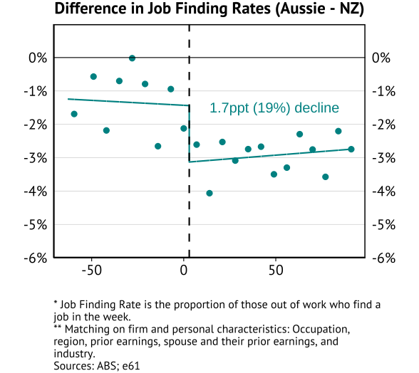
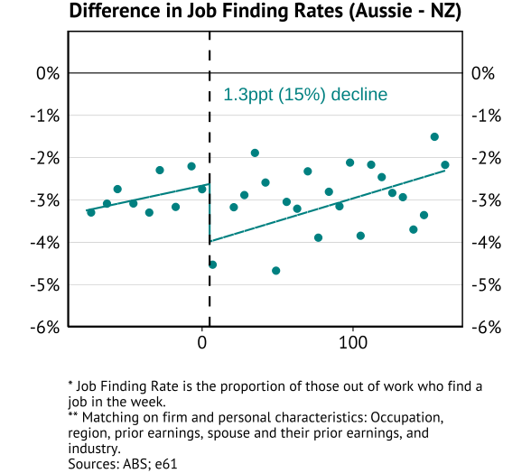
Job finding rate - DiRDD
March announcement
July announcement
Extensive margin elasticity of -0.24 if assumed permanent (and a 80% increase in avg benefit rate)
– need to calculate PV change to get real elasticity. [Similar to standard elasticities in Aussie and overseas.]
Notes:
Notes: 1) If the labour market shut down and this had differential effects we would expect this to REDUCE the gap between the two groups (diff would be biased towards zero). As a result, this makes an estimated increase in the difference a stronger result. 2) For the second announcement is we use the actual announcement date then the estimated effects become very small – in a similar way to the reduction on the next slide. 3) Benefit recipients could work and keep receiving the supplement – as long as they did not cross the specific threshold associated with benefit receipt. Would be useful to add bunching around the eligibility threshold to this piece of work.

Slide 10
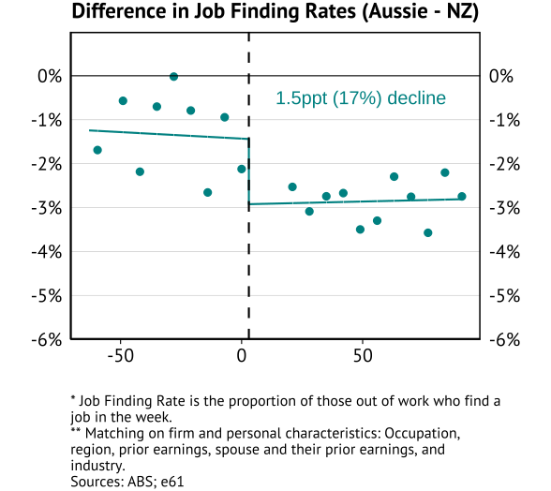
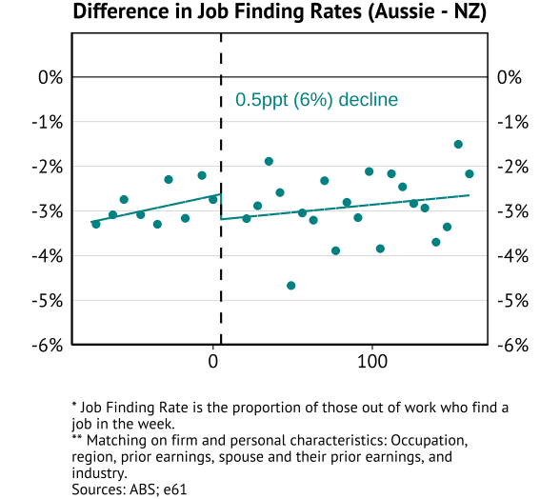
Job finding rate – DiRDD (excluding first fortnight)
March announcement
July announcement

Slide 11
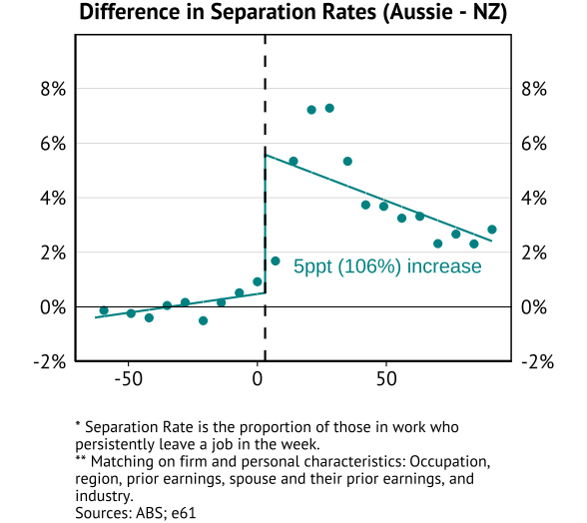
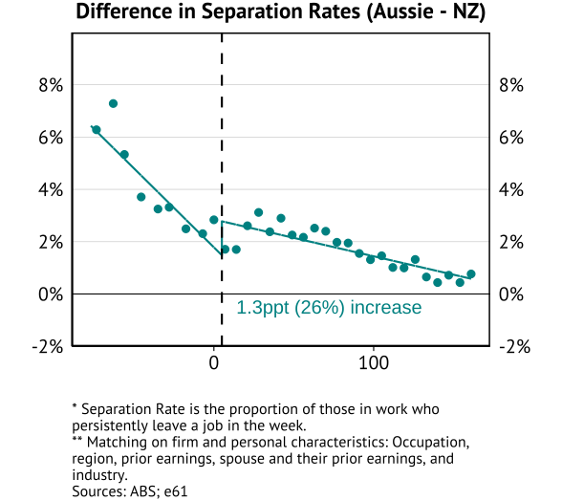
Separation rate - DiRDD
March announcement
July announcement

Slide 12
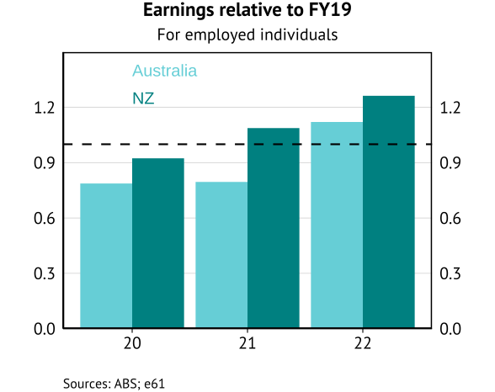
What about match quality?
Earnings growth for New Zealanders tended to be stronger coming out of COVID.
Implies there is no evidence these Australians benefited in terms of higher match quality in future employment.
This is consistent with the vast majority of overseas studies.

Slide 13
Labour supply responses to the COVID supplement
Erin Clarke, Matt Nolan, Ali Vergili

Slide 14
What are we asking?
Research question: how do people respond to changes in the benefit rate?
In order to answer this, we focus on the introduction of the COVID supplement in 2020.
By examining the effects of increased JobSeeker payments, we can assess whether people were encouraged to remain unemployed or if the support helped sustain engagement with the labour market during a period of limited job opportunities.
COVID-19 effects are complex, but using New Zealanders in Australia as a control helps isolate the effects of JobSeeker changes. New Zealanders share many similarities with Australians but couldn’t access JobSeeker and were unable to leave the country, providing a valuable comparison.

Slide 15
Motivation
Understanding labour supply responses to benefit rates can help us understand what the optimal benefit rate and structure might look like.
Furthermore, in order to think about the role of interventions in future crises we need better evidence on the impacts of such support during COVID.
This was a large programme:
During COVID-19, over 1 million JobSeeker claims were processed in just 55 days, highlighting the crucial role of income support for Australians in crisis.
There is debate about labour supply effects of interventions during COVID:
Borland (2020) examined whether the increased JobSeeker payment might disincentivize job-seeking – and found little response.
However, Sainsbury et al (2022) looking at the early release of superannuation did find large employment responses for a smaller PV benefit than the COVID supplement. While Lane and Liu (2024) saw large hours responses to this early release policy.
There is a wider question of how generalisable such responses are to “normal” economic circumstance – this will require further work.

Slide 16
What do we find?
Large reduction in job-finding rate (19%) and increase in separation rate (doubling) following the announcement of COVID supplement.
Limited response to the announced extension of the COVID supplement.
First announcement (March) coincided with removal of mutual obligations, second announcement (July) with their reintroduction – suggestive evidence of large employment effects of such obligations (i.e. Herault and Wilkins 2020).

Slide 17
Second announcement
First announcement

Slide 18
Approach
There were three COVID supplement announcements in 2020. We use a Regression Discontinuity approach to evaluate if job-finding rates and separation rates changed following the first two of these announcements.
Both announcements increased the present value of being on the benefit. As a result, we would expect:
A reduction in job-finding rates as individuals reduce job search effort.
An increase in separation rates as individuals leave low value jobs.
However, these announcements were not exogenous – policies were announced due to economic shocks that will have also reduced job-finding rates and increased separation rates.
We construct a counterfactual group of New Zealanders who live in Australia – who were ineligible to receive the COVID supplement but experienced the same economic and health shocks – and estimate an RDD of the difference in job-finding and separation rates for Australians and New Zealanders.
The data used is transactional STP (tax return) and DOMINO (benefit) data, analysed on a weekly basis. Visa data is used to identify New Zealanders who are unable to access support, and the group of Australians and New Zealanders considered is found through matching.

Slide 19
New Zealanders as a control group
New Zealanders have similar educational and cultural backgrounds to Australia – New Zealand is included in the Australian constitution.
New Zealanders have unlimited work rights, access to health care, and for most policies are treated as Australians (i.e. Family Tax Benefit).
However, New Zealanders cannot receive the JSP or NDIS.
New Zealanders have free travel between New Zealand and Australia. However, during COVID the borders closed (from late March) and the cost of travelling increased substantially.
As a result, a historically small number of New Zealanders left in the June quarter of 2020 – and departure numbers only returned to historically “normal” levels afterwards.
We focus on New Zealanders and Australians who remained in the country during 2020.

Slide 20
Data construction
We use a dataset of matched Australians and New Zealanders (the matching is discussed below).
The Australians and New Zealanders that are considered had to spend time out of work in 2020 – if we limit our sample to those who experience job loss in 2020 the estimated effects become larger.
Due to limitations in the STP, we only consider firms that exist in the STP data prior to July 2020. Furthermore, we drop individuals that are only observed to work in the “new” firms from the analysis. This has little effect on our results.
We append PAYG annual data for FY19 to FY22, along with Visa and benefit data, to form our dataset.
Our announcement dates are:
First announcement: 22 March 2020 – the day the COVID supplement was announced along with other economic measures due to earlier lockdowns and breakouts.
Second announcement: 23 June 2020 – when it was indicated that there would be further extensions in the JSP due to lockdowns, but no details were given. An alternative second is 21 July 2020, when it was announced that the extension would involve a lower payment and mutual obligations.

Slide 21
Summary stats – Aussies & Kiwis
Not cleared yet
Graphs/table

Slide 22
Matching
How do we find comparable groups of Australians and New Zealanders?
Solution: To address this, we use a matching approach to create a comparable group of Australians.
We calculate each individual's likelihood of being in the JobSeeker recipient group based on:
Age, Gender, Previous Income (individual and family), Marital Status, Region (State and SA4), Industry, Occupation (1 and 2-digit ABS code).
Using these factors, we generate propensity scores to estimate the probability of receiving JobSeeker benefits.
Matching Step: Each unemployed New Zealander is matched to an Australian JobSeeker recipient with the closest propensity score, creating a balanced comparison group.
We perform this matching 1-1 on all Australians and New Zealanders in our dataset.
We split the matched Australians into “JSP recipients” and “non-JSP recipients” on the basis of whether they received the NewStart Allowance or JobSeeker Support during 2020.
Our final dataset is then the Australians who become JSP recipients and the New Zealanders that are matched to them. The non-recipients (and related New Zealanders) are then used as a placebo check of our results.

Slide 23
Summary stats after matching (main specification)
Not cleared yet
Graphs/table

Slide 24
Job-finding rate - motivation
The job-finding rate is the key margin that is often considered when trying to understand if a change in benefit settings influence labour supply behaviour.
A lower job-finding rate following an increase in benefit generosity may reflect moral hazard – in so far as individuals reduce job search effort.
However, it may also reflect a reduction in liquidity constraints for individuals, allowing them to search for an optimal job match.
Borland (2020) indicated that there appeared to be little response to the job-finding rate in Australia to the COVID supplement. Furthermore, Ganong et al (2024) found a small employment response to higher benefit payments in US.
Much of the literature is focused on disincentive effects for individuals with relatively long unemployment periods (i.e. Chetty et al 2007).
However, our control group allows us to look at this question in a novel way.

Slide 25
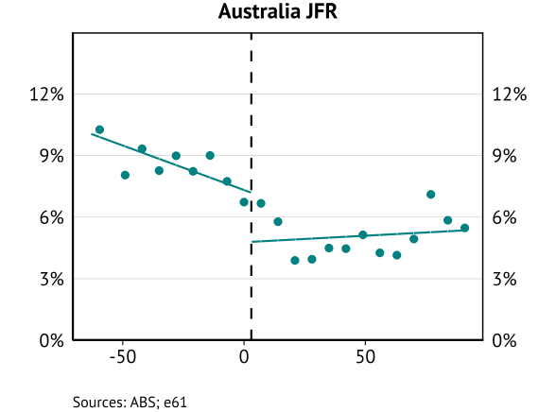
Job Finding Rate RDD - Australians
Sharp drop in Australian job-finding rate.
However:
Sharpest decline a couple of weeks later.
Other policies (JobKeeper) and events (lockdowns, COVID outbreaks).
Cannot attribute this decline to the payment alone due to the economic and health factors at play.
Notes:
Note: If the announcement of a time limited payment did increase in PV of the benefit you would expect a drop at announcement, and increase in the trend post-announcement (as the PV of the benefit will fall through time). As a result, both the drop and change of slope reflect evidence of a response.

Slide 26
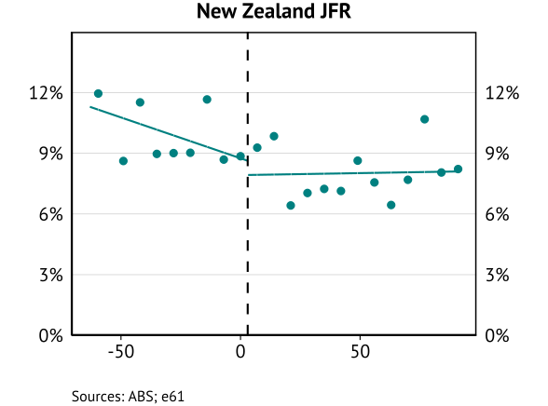
Job finding rate RDD – New Zealanders
A drop in NZ citizen job-finding rate – especially a couple of weeks after the announcement.
Lower job-finding rate persists, illustrating that there were fundamental economic and health factors suppressing job-finding.
Notes:
July result is sensitive to the announcement date – if we use a week later there is no change. The March announcement result is more robust.

Slide 27
Job finding rate - DiRDD
March announcement
July announcement
Notes:
Notes: 1) If the labour market shut down and this had differential effects we would expect this to REDUCE the gap between the two groups (diff would be biased towards zero). As a result, this makes an estimated increase in the difference a stronger result. 2) For the second announcement is we use the actual announcement date then the estimated effects become very small – in a similar way to the reduction on the next slide. 3) Benefit recipients could work and keep receiving the supplement – as long as they did not cross the specific threshold associated with benefit receipt. Would be useful to add bunching around the eligibility threshold to this piece of work.

Slide 28
Job finding rate – DiRDD (excluding first fortnight)
March announcement
July announcement

Slide 29
Job finding rate – non-benefit group
March announcement
July announcement

Slide 30
Separation rate - motivation
Job-finding is not the only margin that may have been influenced by a higher benefit. Specifically, a higher benefit may lead individuals to leave a job – as the present value of the payment received when not working is higher.
Part of the rationale for the COVID supplement was to allow individuals to leave work – due to the health crisis that was underway. As a result, both the size of the increase and the responsiveness of individuals to the payment will have been influenced by this.

Slide 31
Separation rate - DiRDD
March announcement
July announcement

Slide 32
What about match quality?
Earnings growth for New Zealanders tended to be stronger coming out of COVID.
Implies there is no evidence these Australians benefited in terms of higher match quality in future employment.
This is consistent with the vast majority of overseas studies.

Slide 33
Discussion/Conclusion
TBD

